Slide 1


Azure SQL for Beginners Performance Troubleshooting High CPU due to anti-pattern queries
Special Edition
#azuresql
aka.ms/azuresql4beginners

Slide 2


Performance is “slow” = Running vs Waiting
Low or
no CPU
High CPU
What queries are the top resource consuming queries or are waiting?

Slide 3



Running vs Waiting Scenarios
High CPU
Waiting
Missing Index
Blocking
Anti-pattern queries
Deadlocks
Lack of resources
Memory Grants

Slide 4

What is an anti-pattern query?
A query that is written or designed in a way that prevents it from executing to its expected performance
CREATE TABLE customers
(tabkey int,
customer_id nvarchar(10),
customer_date datetime,
customer_type char(500) not null
);
CREATE NONCLUSTERED INDEX [idx_customer_id]
ON [dbo].[customers] ([customer_id])
CREATE or ALTER PROC getcustomer_byid @customer_id int
AS
SELECT * FROM customers WHERE customer_id = @customer_id;
GO
Implicit conversion = Cannot use index

Slide 5
The troubleshooting process
Is there a warning?
Identify High CPU
Find Top Resource Consuming Query or Queries by CPU
Look at the Query Plan
Right index exists but not used
Observe if performance has improved
Is an anti-pattern query?
Fix query
Try it yourself at https://aka.ms/azuresqlworkshop

Slide 6
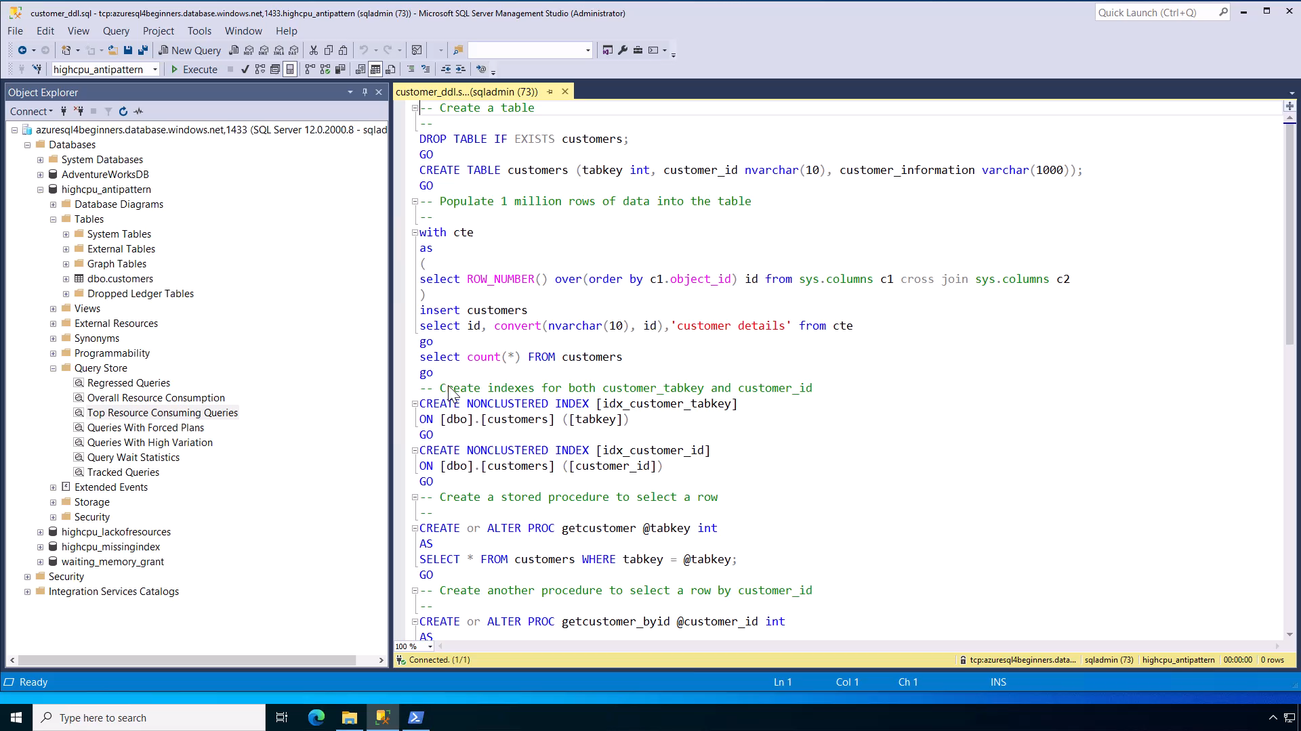
Notes:
30 secs

Slide 7
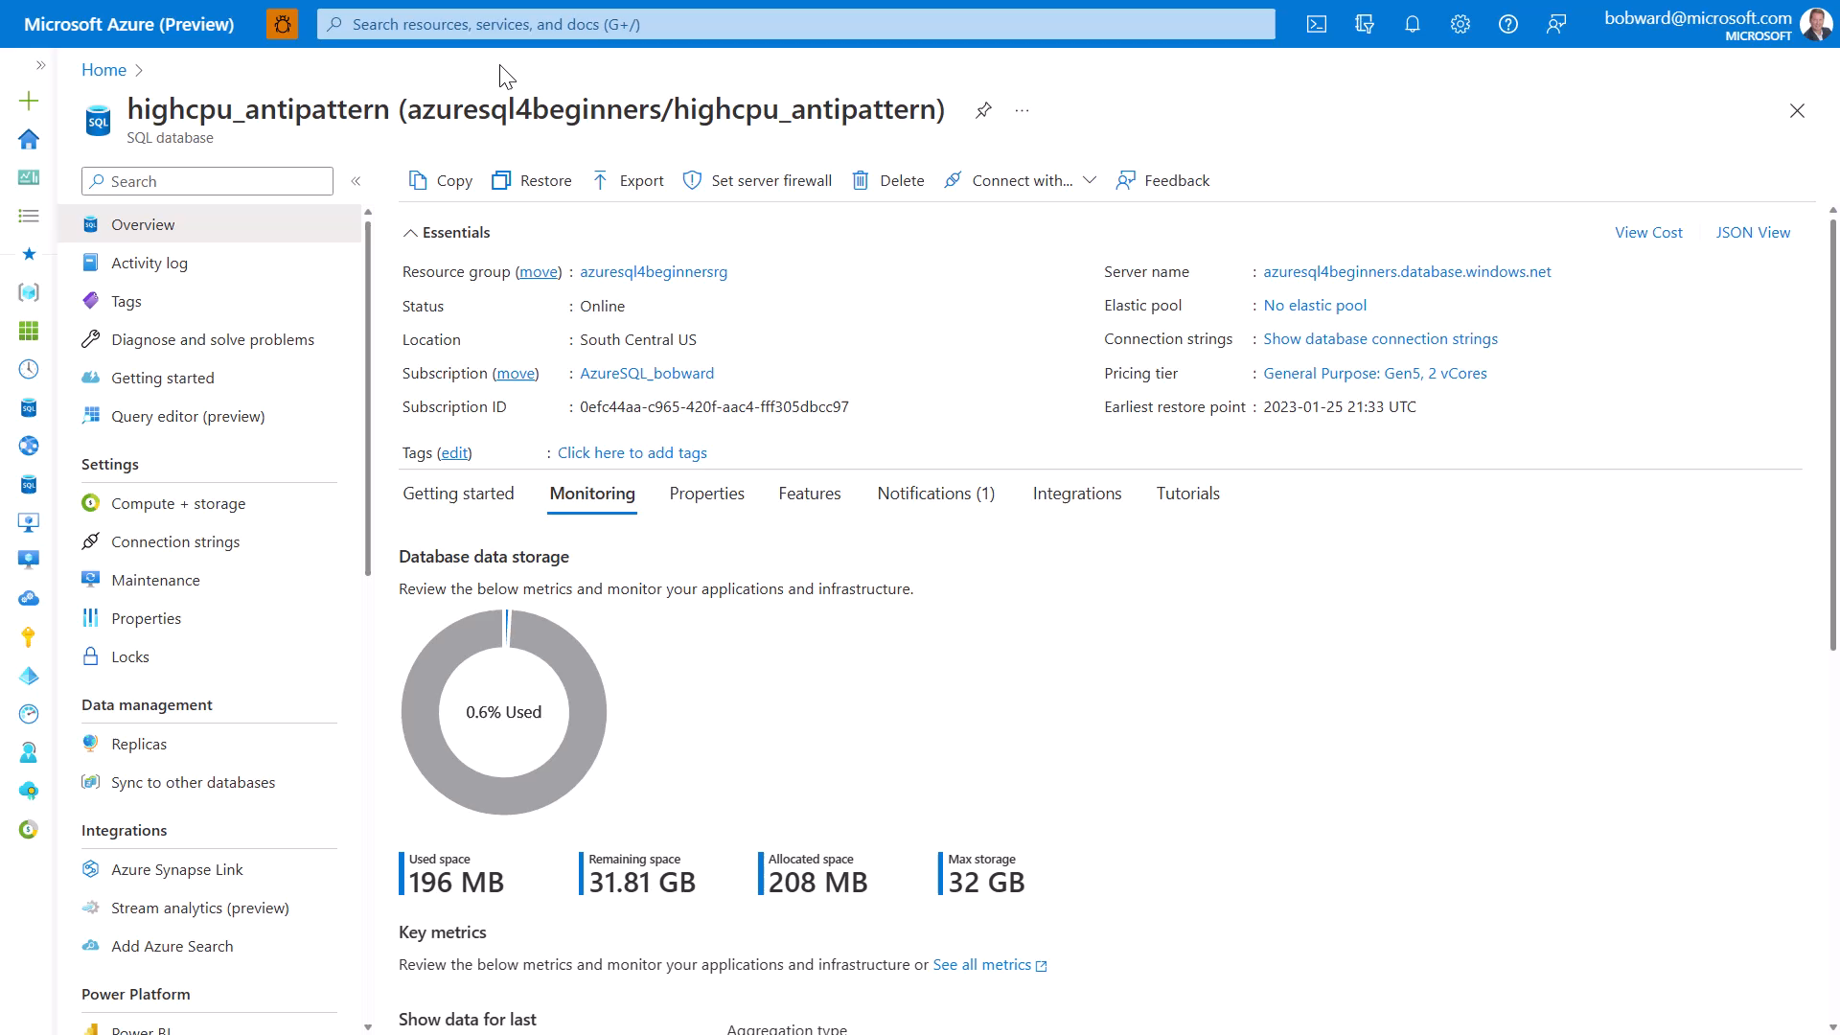
Notes:
30 secs

Slide 8
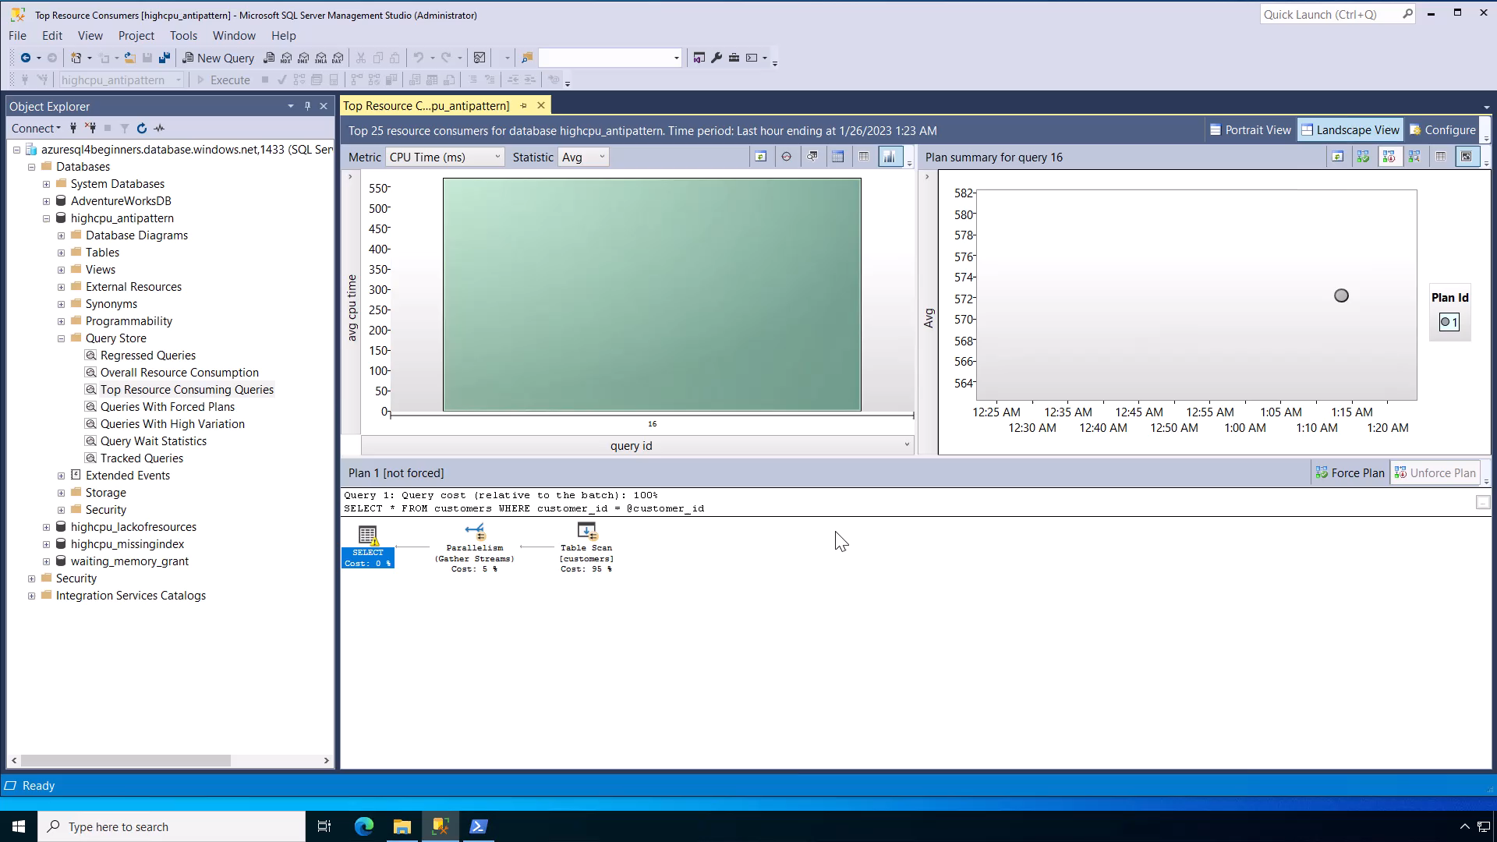
Notes:
1 min

Slide 9
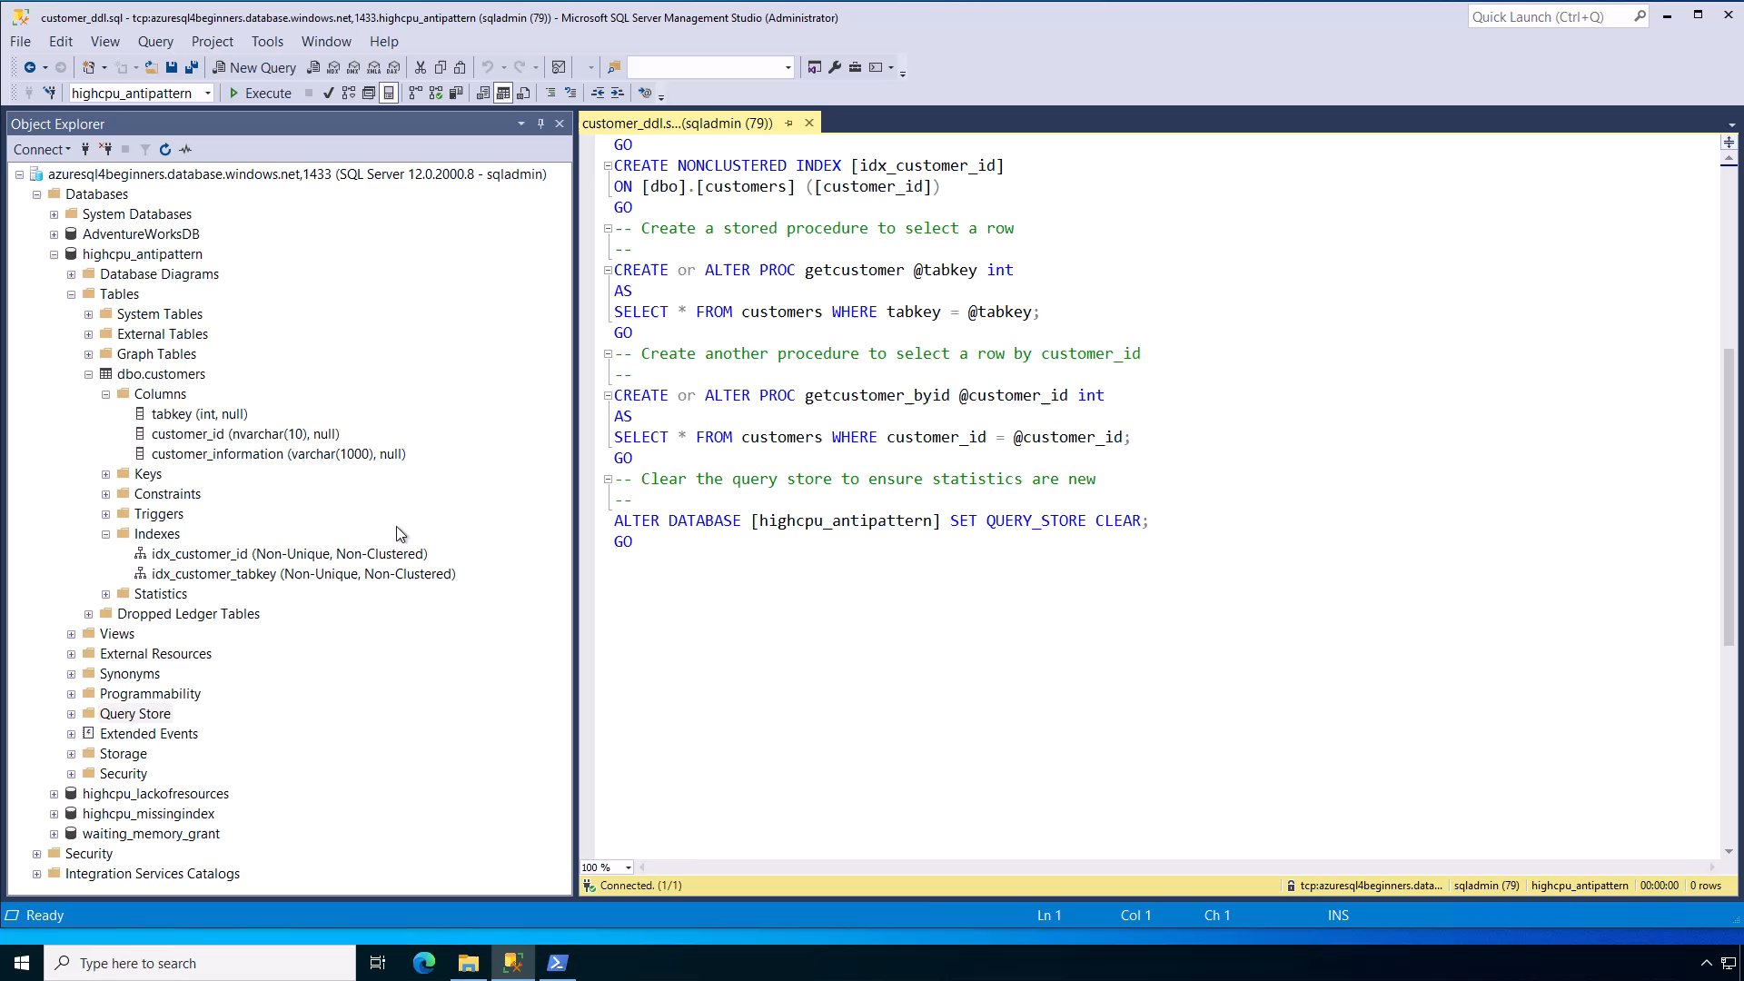
Notes:
30 secs

Slide 10
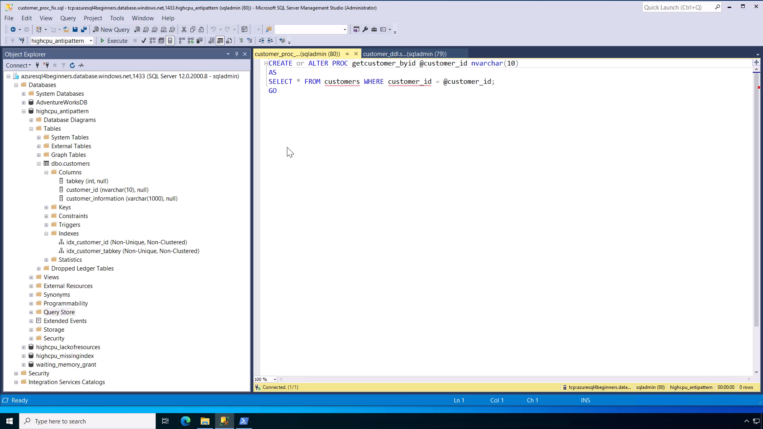
Notes:
30 secs

Slide 11
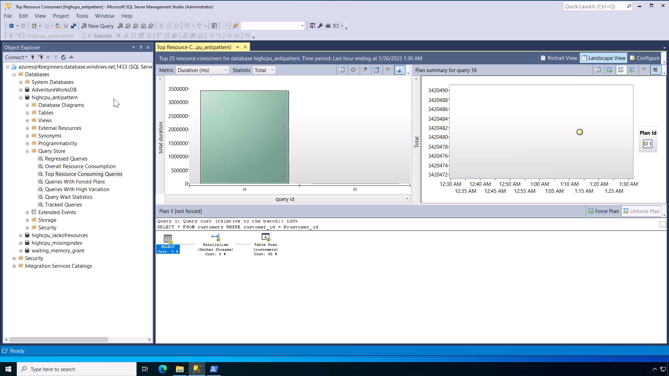
Notes:
30 secs

Slide 12
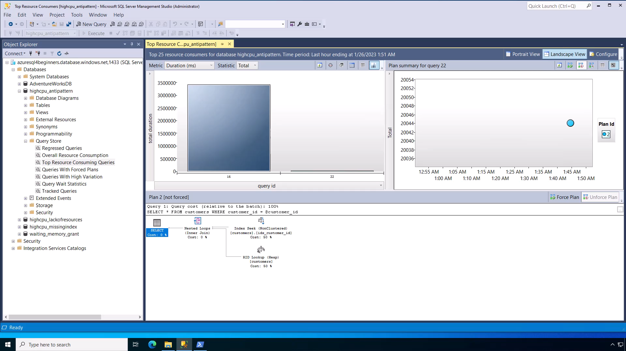
Notes:
30 secs
Demo total = 4 mins

Slide 13
Anti-pattern query examples
aka.ms/sqlantipattern
Non-parameterized/ad-hoc workloads
Improper transaction management
Non-SARGable predicates
Implicit type conversions prevent index usage*
Large IN clause**
Large number of OR predicates**
Non-optimal use of OR**
* Detected by SQL Server as warning in query plan
** Detected by SQL Server with Extended Events
Notes:
SARGable = Search ARGument ABLE which means can the query predicate (i.e. WHERE) use an index

Slide 14
Summary
SQL performance problems are either running or waiting.
SQL performance problems typically involve finding out what queries are involved.
If you identify a High CPU problem, find the top resource consuming query or queries by CPU.
Check the query plan to see if an index is missing.
If the right index exists but not used, you could have an anti-pattern query.

Slide 15



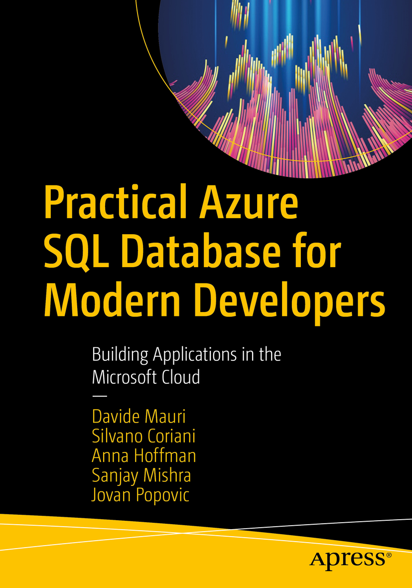


Learn more
Learn more about anti-pattern queries
aka.ms/sqlantipattern
Azure SQL for Beginners
aka.ms/azuresql4beginners
Azure SQL Workshop
aka.ms/azuresqlworkshop
aka.ms/azuresqlbook
Azure SQL Fundamentals
aka.ms/azuresqlfundamentals
Watch Data Exposed
aka.ms/dataexposed
See more videos from our team
aka.ms/azuresqlyt
Follow us on social media
aka.ms/azuresqltwitter
aka.ms/azuresqlfordevelopers

